Slide 1


IFMS Source Code Management Strategy v.1

Slide 2
Introduction
This presentation is to discuss the implementation of the gitflow process development model, how it works, and why we must proceed with this method of development

Slide 3
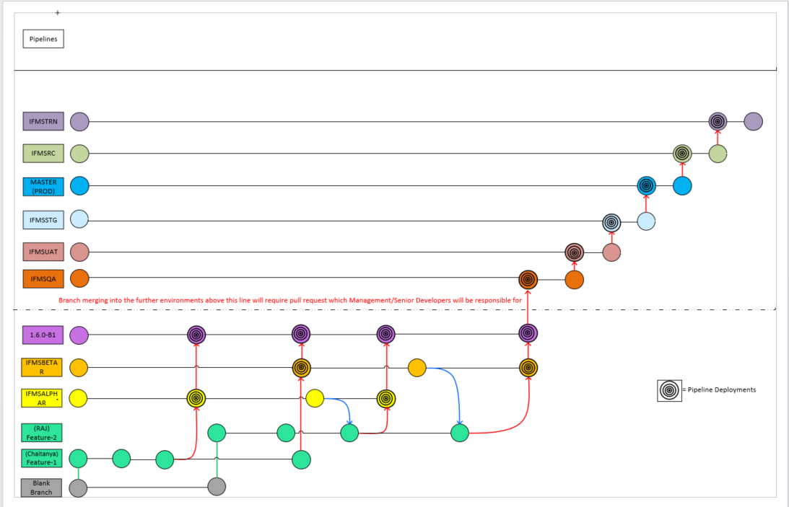

Slide 4


Tools
Please see the pre-requisite tools necessary to facilitate this task
Vscode
Atlassian Cloud account with Bitbucket Access
  Should be integrated with your Jira access. If there are any issues logging into bitbucket please reach out to nicholas.sampah@caci.com

Slide 5
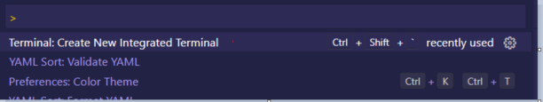
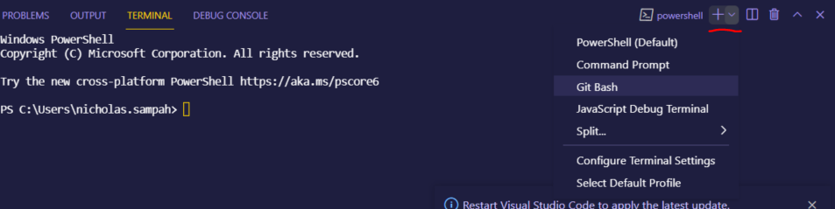
Open bash terminal in vscode
CTRL + Shift + P to open the vscode command pallet
From the drop down select bash terminal

Slide 6
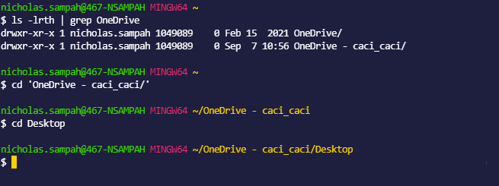
Navigate to your Desktop

Slide 7
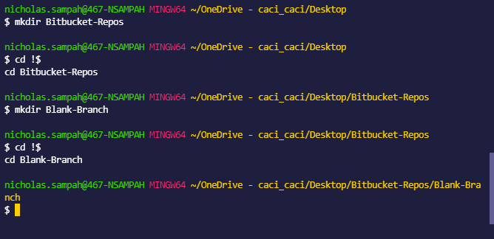
Create and execute into local directory

Slide 8
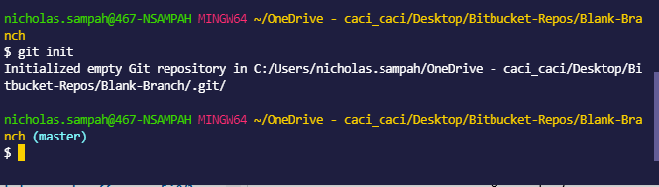
Initialize your repository

Slide 9
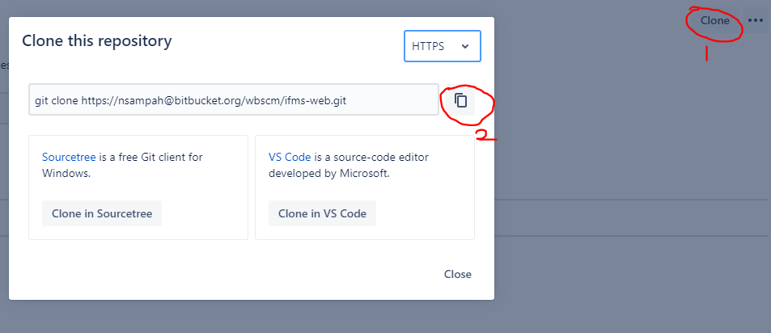
Clone the IFMS Repo from Bitbucket
Navigate to https://bitbucket.org/wbscm/ifms-web/src/master/ and click clone
Copy the generated ‘git clone’ cmd syntax

Slide 10
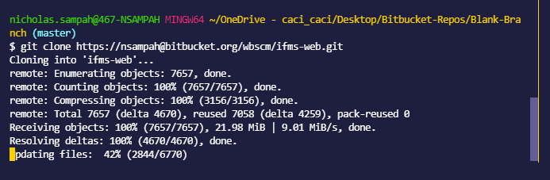
Clone the IFMS Repo from Bitbucket
Paste the customized command into your vscode git bash command line

Slide 11
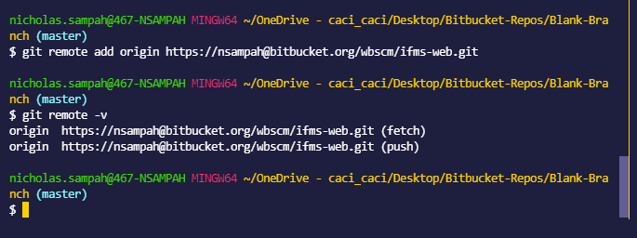
Add the IFMS as a remote repository in git
Git remote –v will validate if your above command executed successfully
Reminder: Please make sure that your hyper text link(http) is the same as that generated from the clone button on the bitbucket console

Slide 12
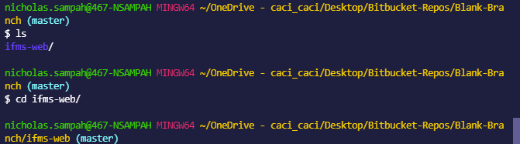
Navigate Into the Cloned Repository

Slide 13
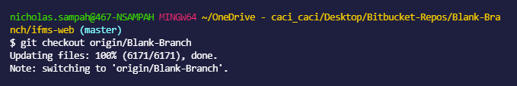
Checkout the Remote “Blank-branch”
Note: this is customized to give you the folder structures necessary to properly develop your features

Slide 14
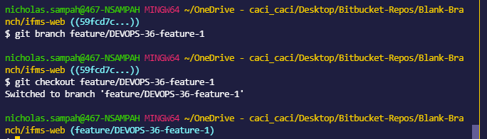
Create and checkout git local feature branch from “Blank-Branch”

Slide 15
Rules to Creating Feature Branches
All feature branches must begin with feature/IFMS-<ticket-number>-feature-<number>
This allows your feature branch to be displayed in the development plane in the jira issue specified
Note you will only be able to see this after your local feature branch is pushed upstream to the bitbucket repository as the software integration is between the two Atlassian tools Jira and Bitbucket, not your local workstation

Slide 16
Make Changes and Update Package.xml
You must always update the package.xml to reflect only the components that you are looking to modify.
It’s the best method we have found to work with the ANT migration tool which is the software responsible for compiling the Apex code.

Slide 17
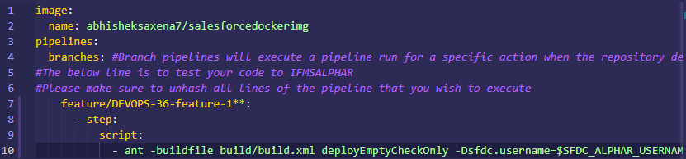
Update the bitbucket-pipelines.yml File
Mandatory
  Unhash lines 7 to 10
  Change line 7 to use your local feature branch name in entirety
    This will deploy “check” your code against the alphar environment
    This code will be using the components declared in your package.xml file without saving the components in the targeted org which is AlphaR
    This is useful for validating tests that would be generated in a deployment
    This allows our pipeline to facilitate continuous integration and continuous testing

Slide 18
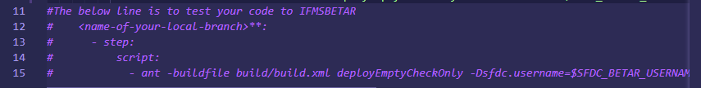
Update the bitbucket-pipelines.yml File
Optional in the first commit but mandatory as the dev cycle continues
  Deploy check your code against the BetaR environment
    Unhash lines 12 to 15 in this file in order to perform a test deployment of the components specified in the package.xml without saving the components in the targeted org which is Betar

Slide 19
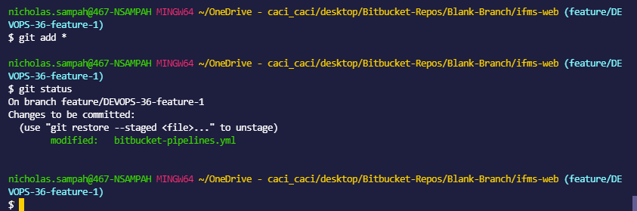
Stage and Verify Changes
Note: you should see more changes than my output shows as this is just for demo purposes

Slide 20
More about Staging Changes
Add all your changes to the git staging environment which you would like to be included as the most up to date milestone to your local feature branch
Method 1: Staging specific changes and files per location
  cd (directory of your changes)
  git add . #This will add all untracked files in the present working directory into the git staging area
  git add <file.name> #This will add a specific file in the present working directory into the git staging area
Method 2: Specify the absolute path of specific files
  #This is very useful for if a change is applied to one file
  git status #This will give you the absolute path of the untracked file
  git add <absolute-file-path> #This command will stage the specified file to the git staging environment.
Method 3: Stage all untracked changes in the local repository
  #This method is useful if several changes have been made to the repository files and file structure
  #This method is a great catch all
  git add *

Slide 21
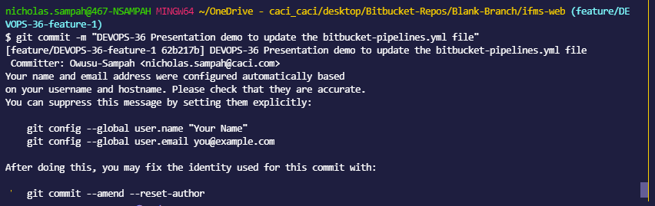
Commit Staged Changes to be Tracked

Slide 22
Rules to Committing Code
Commits must begin with an IFMS Jira ticket number
  This is important because it allows your changes and updates to be integrated with a specified Jira ticket
  This allows greater transparency with stakeholders and in turn increases the trust in the good work we do
  It is beneficial to the development team because simply put it assists your work to speak for itself regarding the stability of changes , what changes are being made, and overall is a great visual representation of what is going on with code and the organization environments during the development process in real time

Slide 23
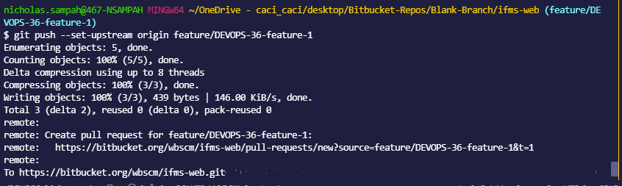
Push the Feature Branch Upstream to Bitbucket

Slide 24
More About Pushing Code to bitbucket
When you develop code on your local workstation your git changes on your currently checkout out branch are being tracked locally per each commit that is made
You will not be able to push changes to bitbucket unless the local repository exists in the remote bitbucket repository or unless you manually set is as an upstream to another branch in the bitbucket repository(which I don’t recommend)
When you push your branch as an upstream from your local repo it allows your branch to begin being tracked in Bitbucket cloud

Slide 25
More about Pushing Code to Bitbucket
After your feature branch is pushed upstream to the remote repository you will not have to execute the upstream flag going forward when your wish to push more changes to that feature branch because it is already being tracked in the remote repo.
The command to push changes after subsequent commits going forward is
git push origin feature/<ticket-number>-feature-<1,2,3,etc>

Slide 26
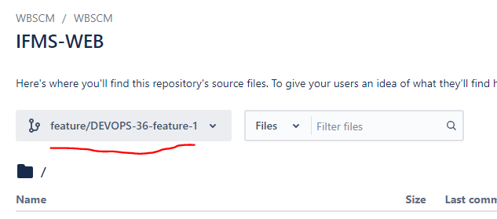
Validate the New Branch is Created in Bitbucket with Your Changes

Slide 27
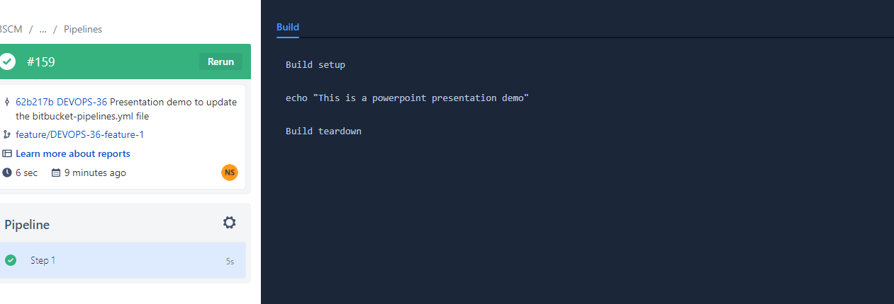
Validate a Bitbucket Pipeline Job has Executed

Slide 28
More About the Bitbucket Pipeline Execution
You can find the pipelines section in bitbucket on the left side of the user interface from the list of choices to select
When we unhashed line 7-10 in the bitbucket-pipelines.yml file and included our feature branch name this allowed an automatic pipeline execution regarding branch pipeline clause line 4 of the bitbucket-pipelines.yml.
Troubleshooting: If the pipeline does not execute automatically per pushing the new feature branch upstream to bitbucket or updating the remote repo from your local changes with subsequent ‘git push’ executions then the syntax of your branch name in line 7 is incorrect

Slide 29
Merge Feature Changes to the 1.(x).0-build-(1,2,3) Branch
Checkout remote build branch Git checkout origin/1.6.0-B1
Create and checkout local branch from the checked out remote branch
  Git checkout -b 1.6.0-B1
Merge your feature branch changes into your local copy of the remote build branch
  Git merge feature/<IFMS-ticket-number>-feature-1

Slide 30
Resolving Merge Conflicts
Open the file in vscode while having the build branch checkout out
There should be an automatic prompt allowing you to select the changes you want to keep and the changes you do not want to keep
After the changes are made restage your changes with ‘git add *’
Create a commit and push your changes with ‘git commit –m “<ifms-ticket-number> commit message”
Push your changes to the build branch
Git push origin <build branch name>

Slide 31
Deployment to AlphaR
When your code is pushed to the build branch (please see branch 1.6.0-B1 bitbucket-pipelines.yml file for your reference and example) the bitbucket pipeline will execute a pipeline deploy action into the alphaR environment
This is configured to deploy only into the alpharR environment but as an option you can update the bitbucket pipelines.yml file to deploy into BetaR once you feel your changes are complete and satisfactory

Slide 32
Why is this Method Important
This method is important because we want the repository to track changes correctly while also ensuring that each developer consistently has the most recent up to date code deployed in the AlphaR or BetaR sandboxes.
When code is pulled from the scratchorgs via vscode and deployed via vscode changes are not tracked in the repository and this gets us in a compliance issue. Down the line it does not bode well for us during auditing
However, when a developer uses the Gitflow model as demo’d above, whenever a merge is to occur into a branch , the git software will first force the developer's local system to pull any updated changes that exists in the sandboxes before the code becomes deployed. This provides visual proof that code is stable and will assist us with code troubleshooting by allowing us the ability to track down changes individually by observing each specified point of change in the branch history.

Slide 33
Questions?

